Slide 1
EOSC Portal
New User Functionalities
Bartosz Wilk - ACC Cyfronet AGH

Slide 2
Mission
Boost European research by providing all necessary interfaces and functionalities to equip EOSC Users with knowledge about and possibility to use the resources available in EOSC for the sake of supporting science across the Europe.

Slide 3
Main functions
Gateway to EOSC Resources
271 categorised and well described, research supporting, resources
Generic resources along with specialised, thematic services (both physical and digital)
Solutions developed for all branches of science
Resource offers tailored to specific use-cases
4 types of access mode
Composability of resources
Communication channel with EOSC Providers and other EOSC stakeholders
128 providers of different kinds (e-infrastructures, user communities, scientific institutions, etc.)
Direct communication with Providers
Possibility to request a new EOSC resource compositions or a new resources
User feedback and resource rating
User support from EOSC Providers and EOSC Experts
Support for individual use cases from EOSC Providers

Slide 4
Please remember
All interfaces and functionalities are meant to be user-driven

Slide 5
See if EOSC can offer you something you need - resource discovery

Slide 6
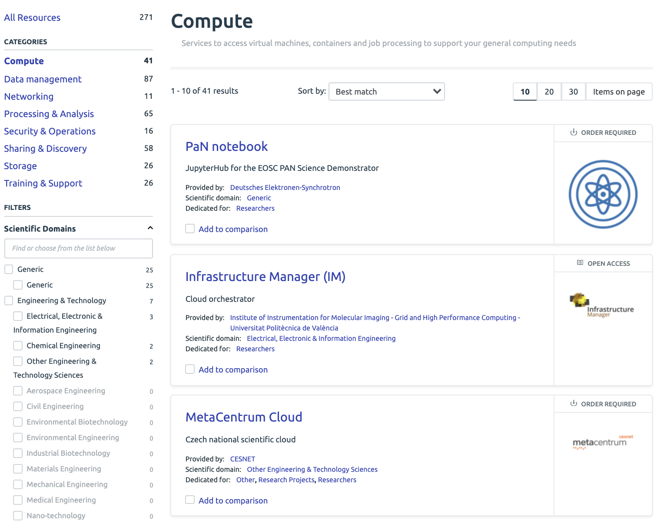
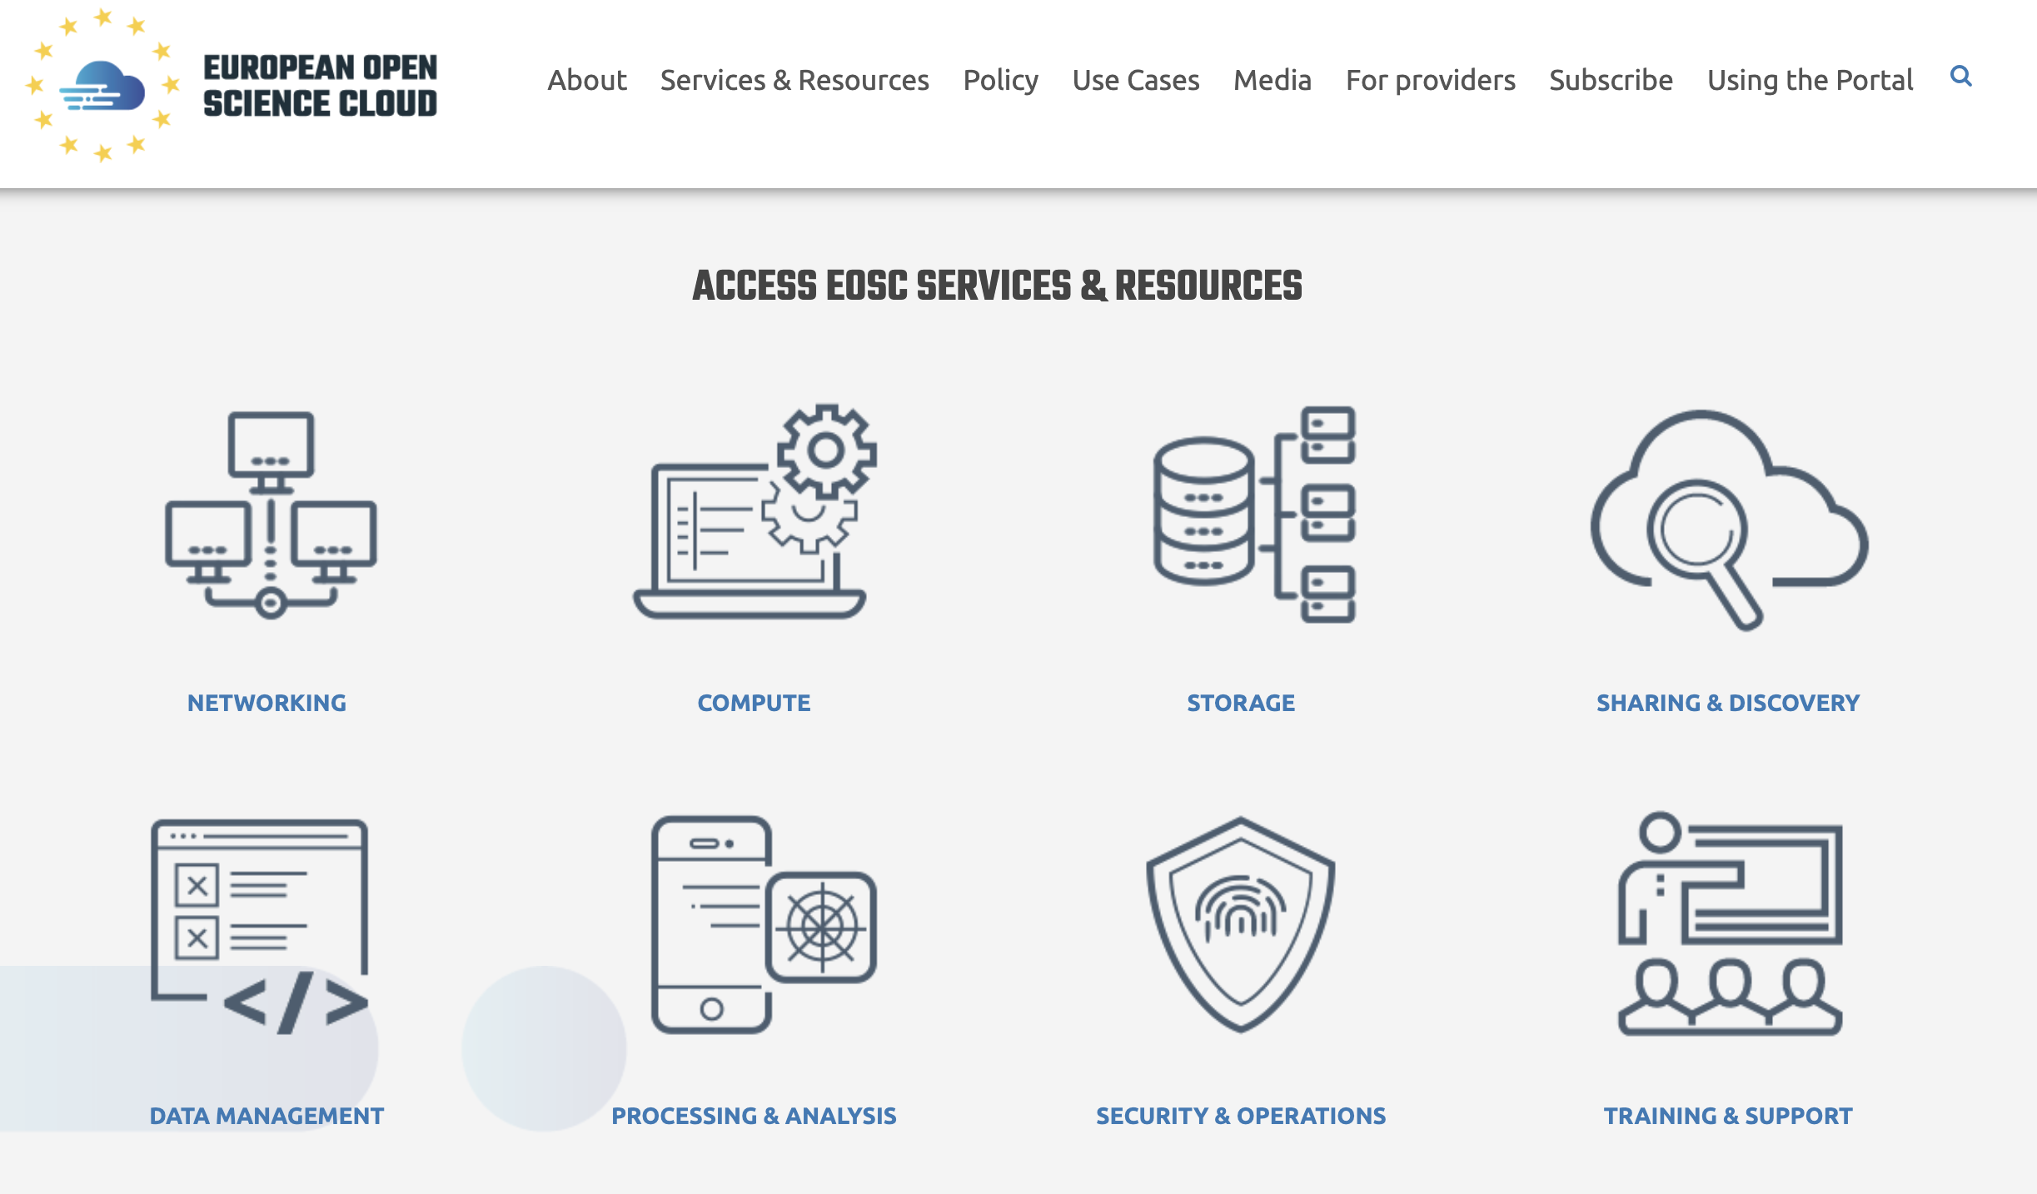
8 categories to start with...

Slide 7
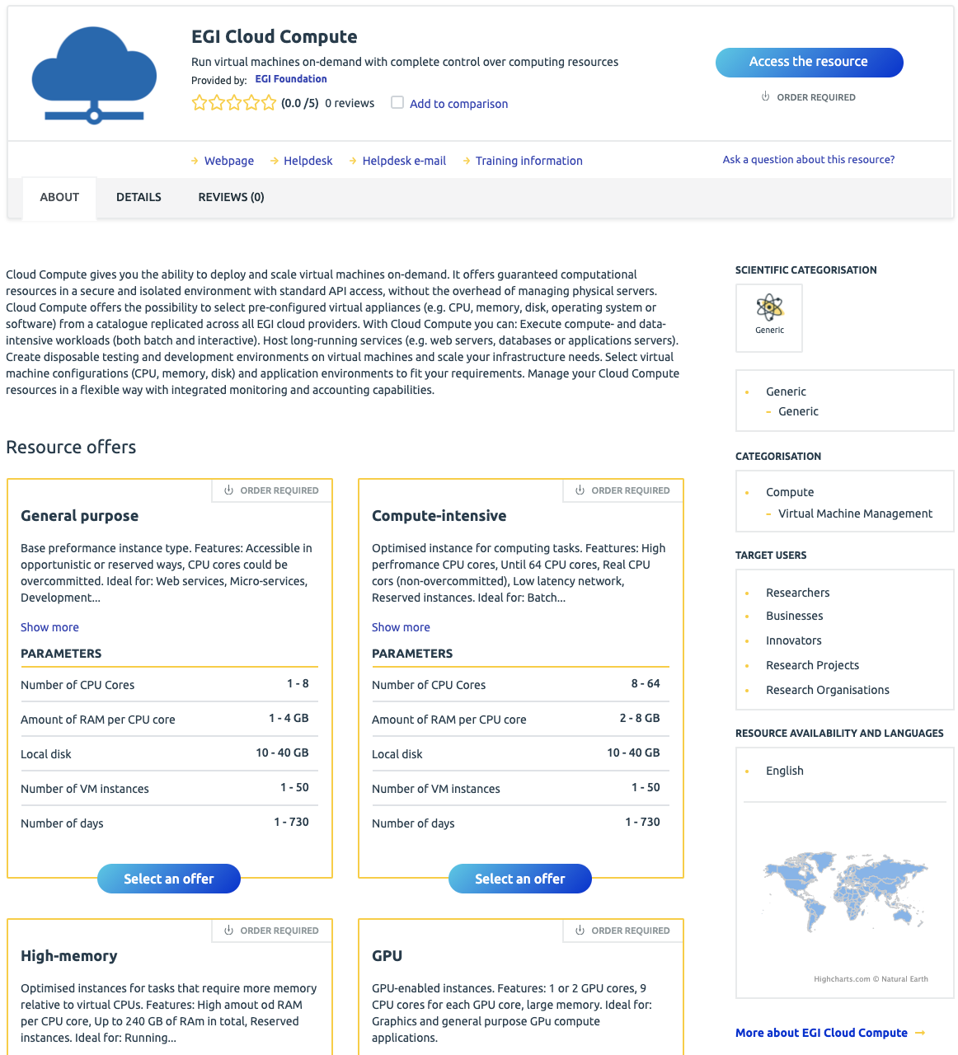
Discovery functionalities 1/4
New resource layout focused at user perception and information clarity
Layout designed to promote the data crucial to assess the resource
More informative resource description (incorporation of the new RDT version)
Tour guide to present and explain new layout
Resource header
Resource classification
About section
Details
Reviews
Resource offers

Slide 8
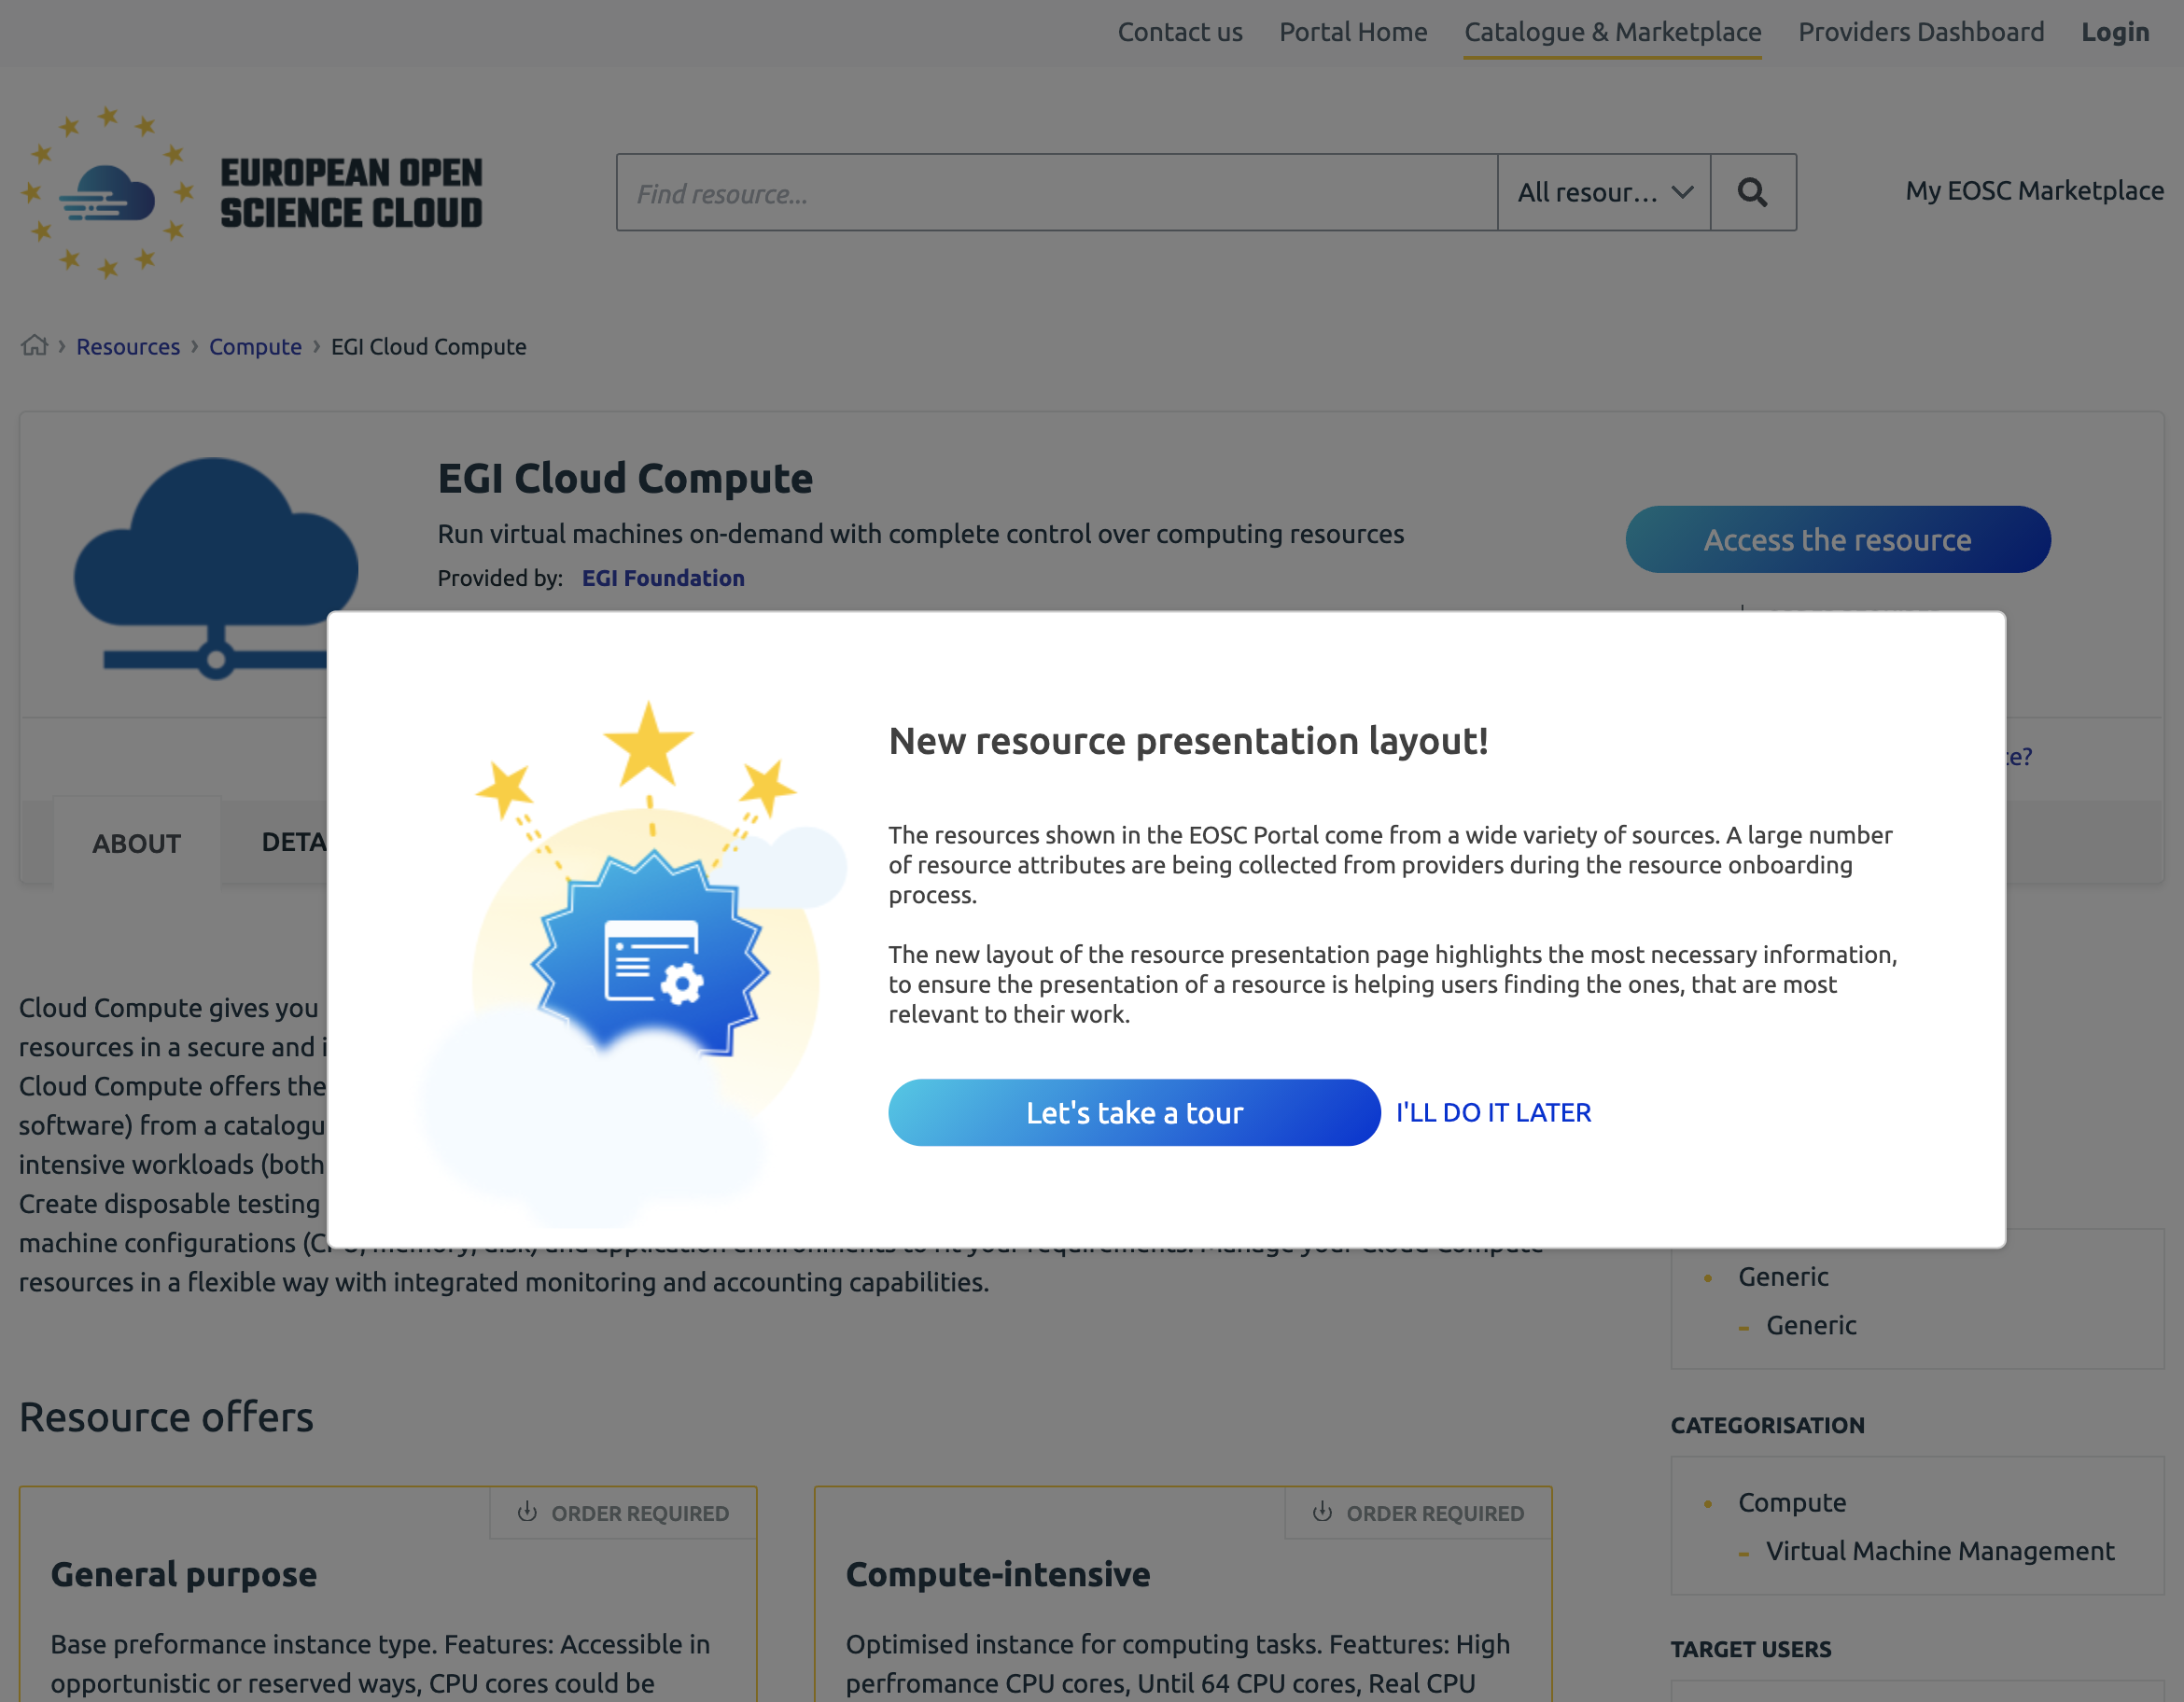
Discovery functionalities 2/4
New resource layout focused at user perception and information clarity
Layout designed to promote the data crucial to assess the resource
More informative resource description (incorporation of a new RDT version)
Tour guide to present and explain new layout
Resource header
Resource classification
About section
Details
Reviews
Resource offers

Slide 9
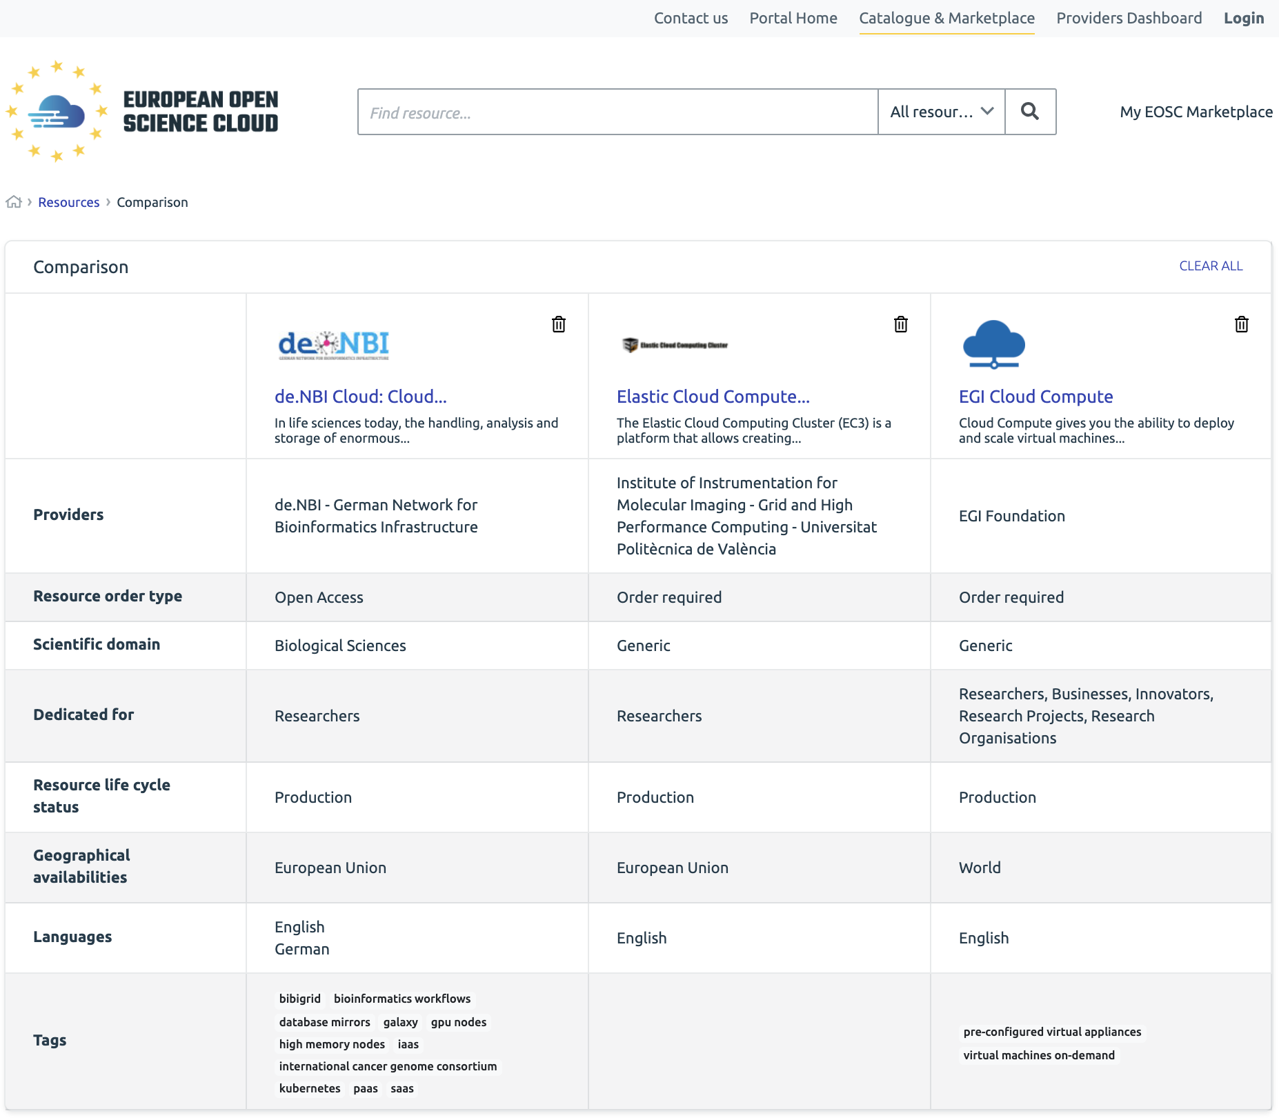
Discovery functionalities 3/4
Resource comparison
Side-by-side review of the key resource metadata
Easy way to find differences
Enhanced search and filtering
Enhanced full-text-search methods to find phrases in various resource and offer metadata such as title, tagline, provider fields or offer descriptions
Resource metadata can be compared by adding resource entries to the comparison tray
New filters allowing more accurate search

Slide 10
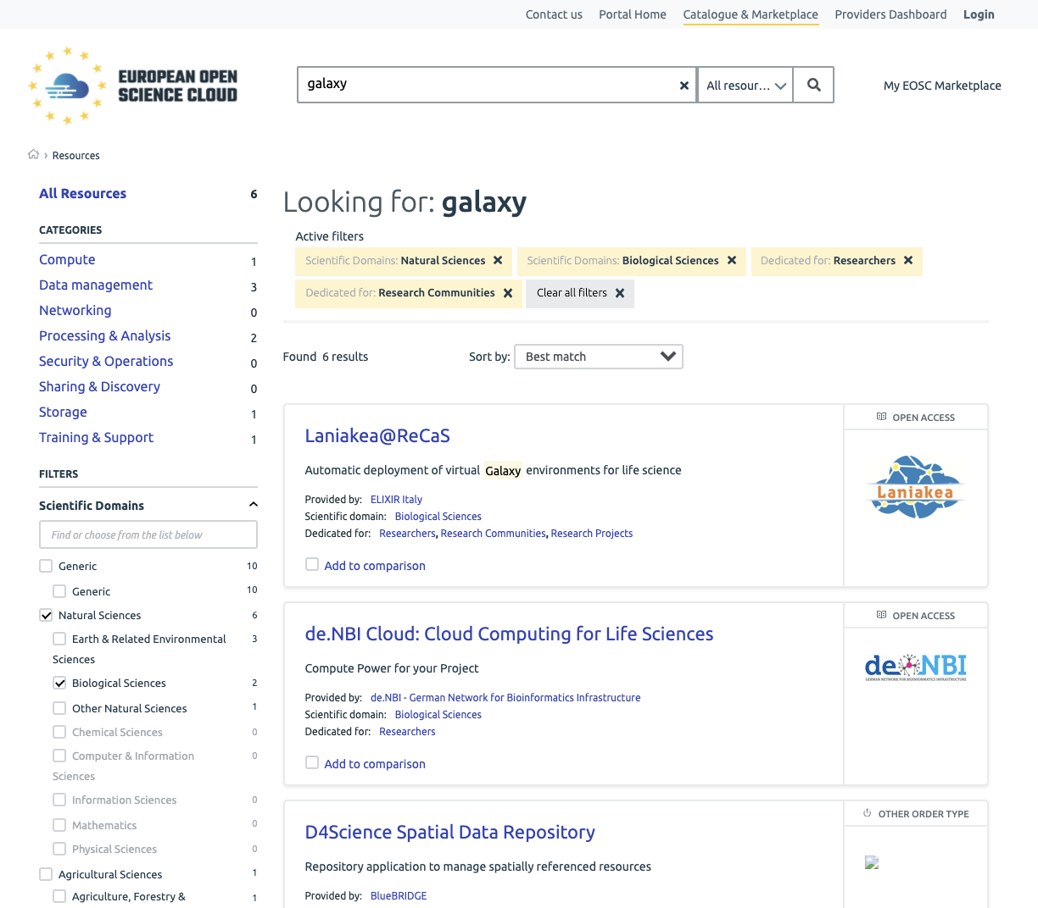
Discovery functionalities 4/4
Resource comparison
Side-by-side review of the key resource metadata
Easy way to find differences
Enhanced search and filtering
Enhanced full-text-search methods to find phrases in various resource and offer metadata such as title, tagline, provider fields or offer descriptions
Resource metadata can be compared by adding resource entries to the comparison tray
New filters allowing more accurate search

Slide 11
Your little piece of EOSC -
the user space

Slide 12
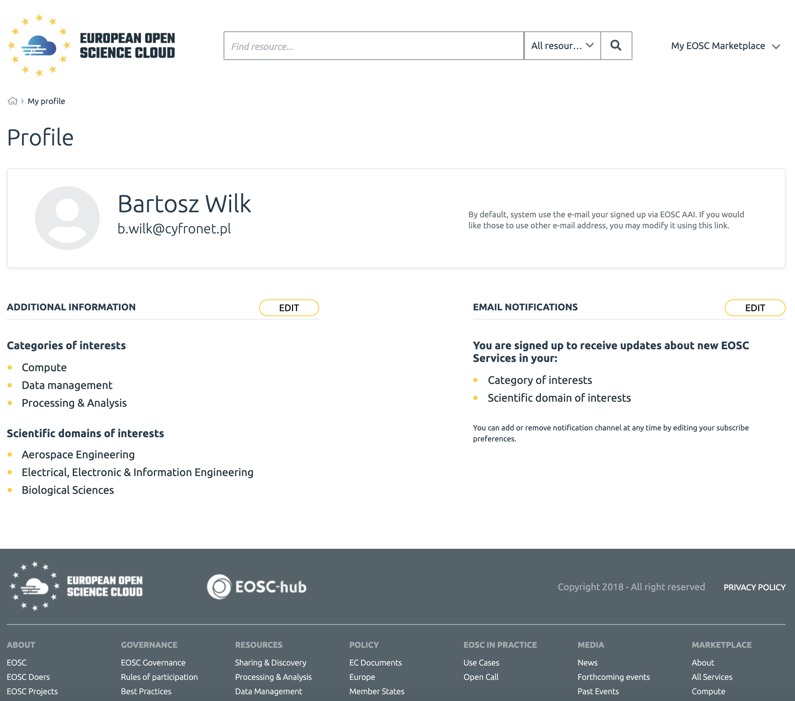
User Profile
Interface meant to collect user-relevant data to serve EOSC user experience-enhancing functionalities
Subscription for notifications about new resources of interest
Coming soon
More user profile properties
Profile based portal personalization
Portal recommendations to help in browsing resources

Slide 13
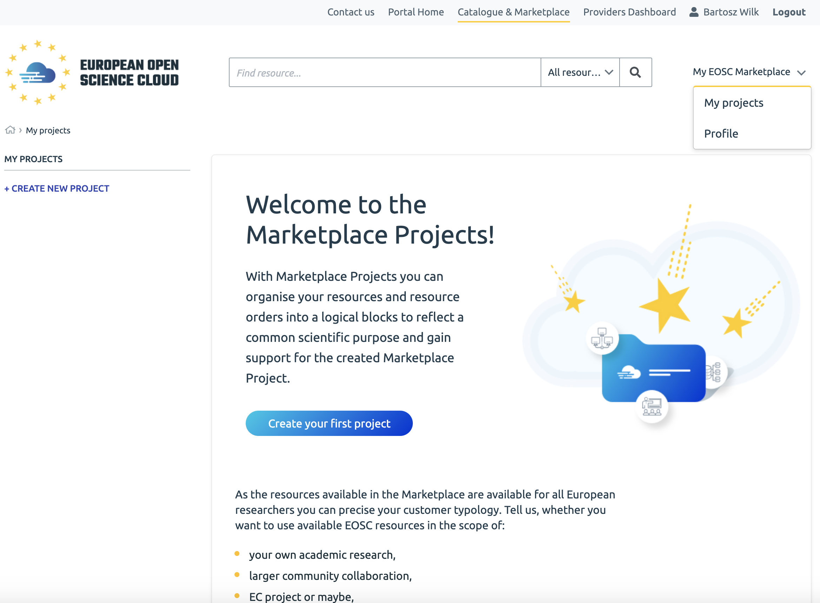
EOSC Marketplace Projects
Organise EOSC resources in a manner that suits your work best
Collect resources for your use case together
Easily access the collection of your preferable resources
Monitor ordering status for your EOSC resources
Interact with the EOSC Experts and EOSC Providers to get support
Rate EOSC resources

Slide 14
If EOSC can help you, use it - accessing the EOSC resources

Slide 15
Resource order type
No. | Order Type | What does it mean | MP visibility
1 | Request/Order required | Accessing the resource requires undertaking an ordering procedure coordinated by EOSC or the Resource Provider
2 | Open Access | No ordering procedure necessary to access the resource but user authentication is required
3 | Fully Open Access | Resource can be used without any constraints
4 | Other | Other/unclassified order type
5 | Various Order Types | Several order types are available for this resource Order type is dependant on the resource offer selection

Slide 16
Accessing the resource
The main access point for the resource is the resource presentation page
The page allows to analyse resource offering and choose the offer appropriate for the desired use case
Depending on the order type of the resource offer, user is guided appropriately

Slide 17
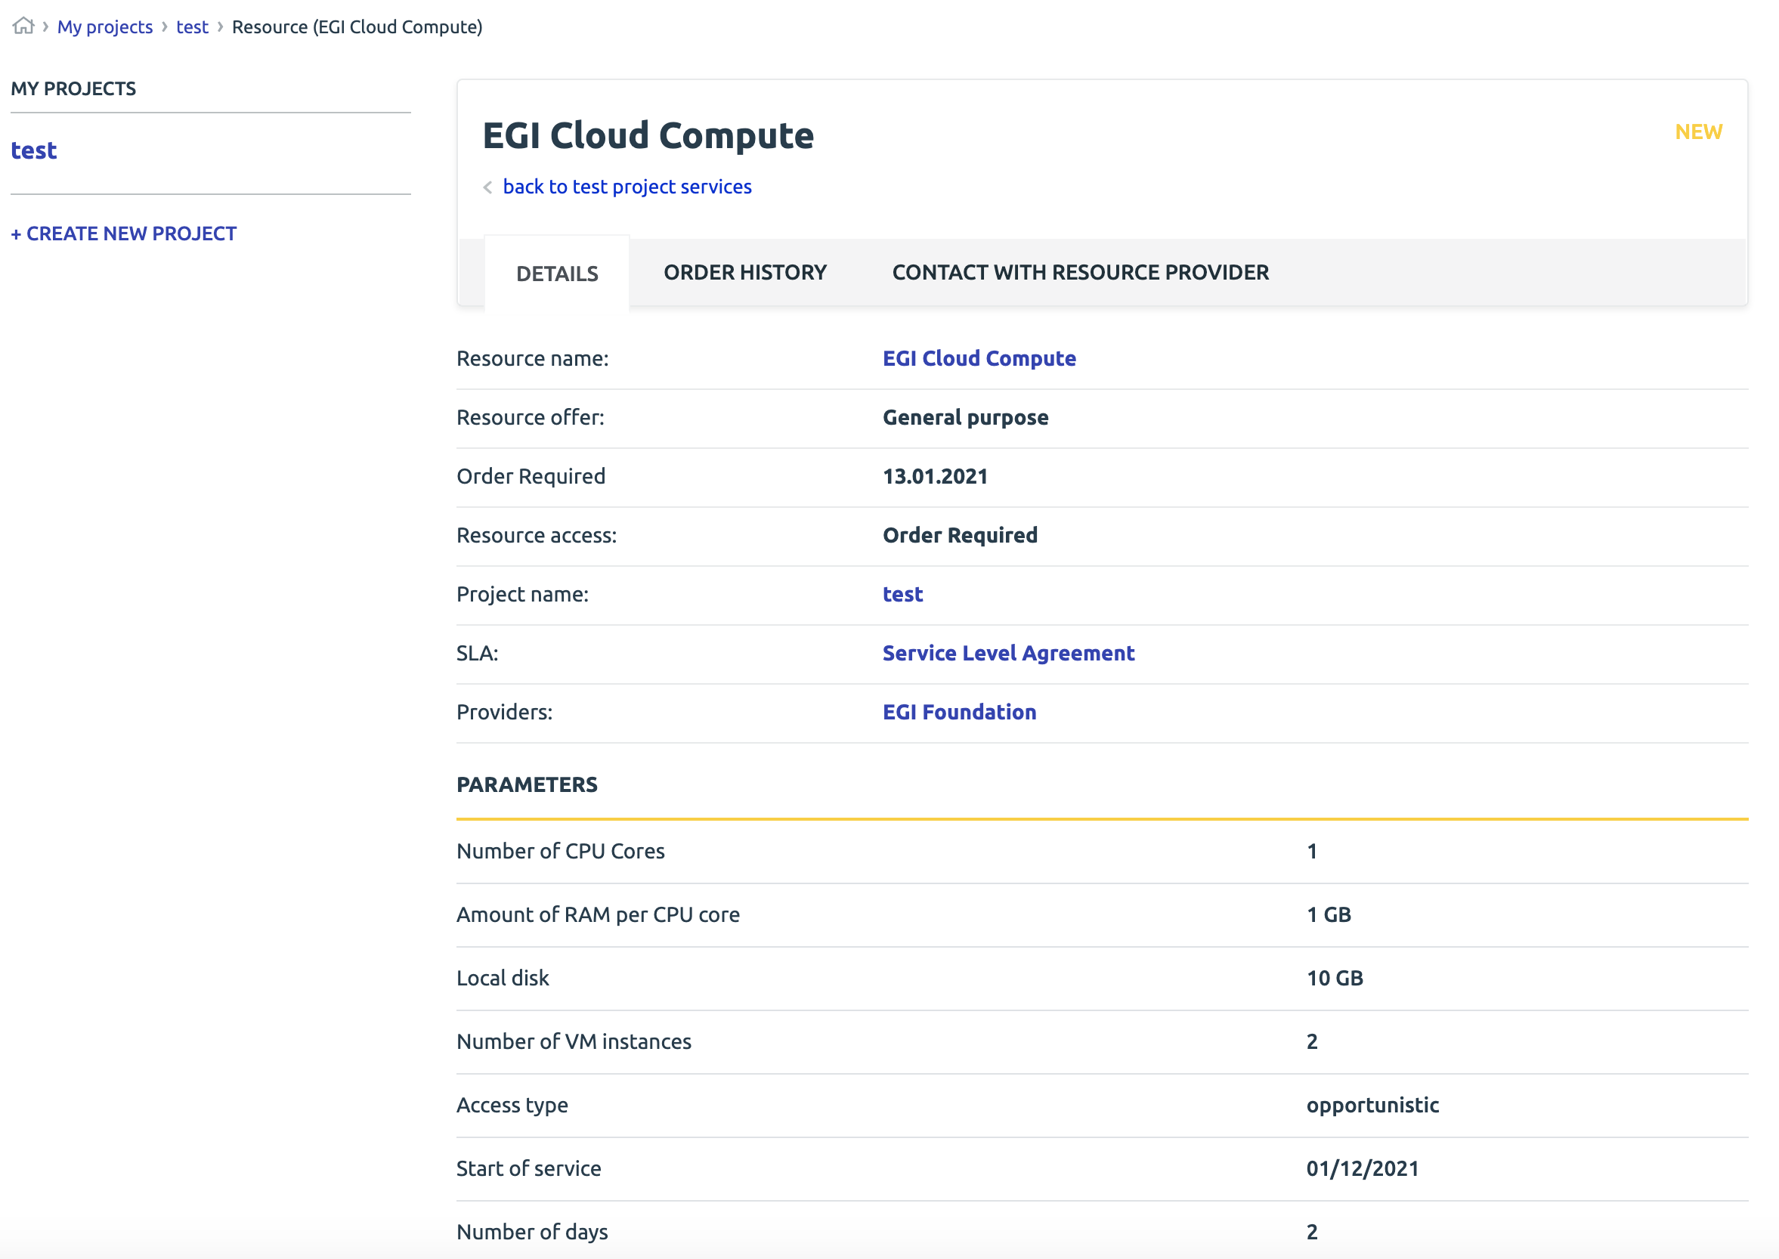
Accessing the resource
Ordered resources are visible, available to track and use when ready in the project panel
All resources may be bookmarked in the projects for the ease of accessibility

Slide 18
Create EOSC with us - user support and feedback

Slide 19
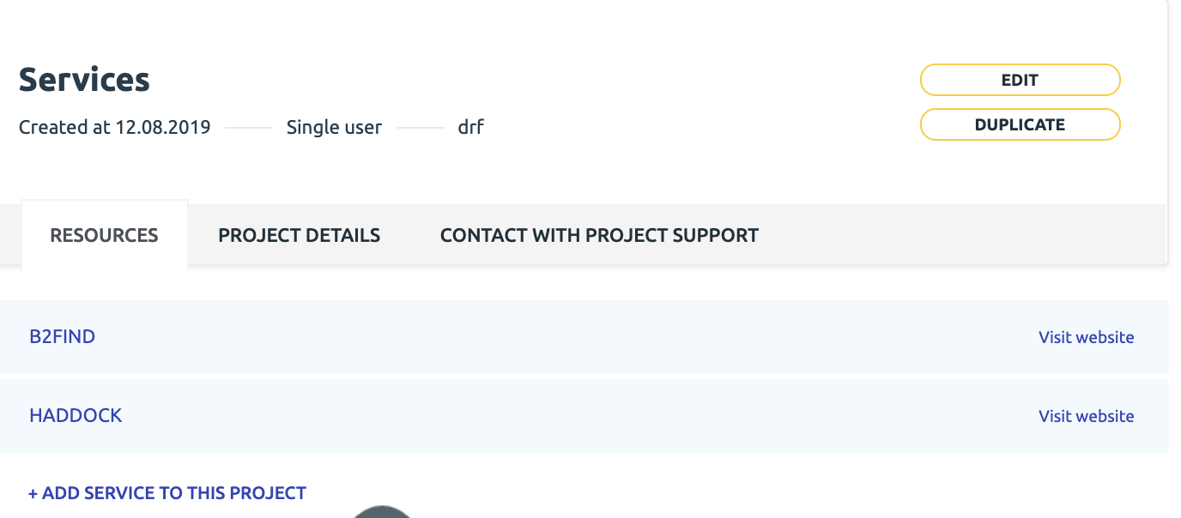
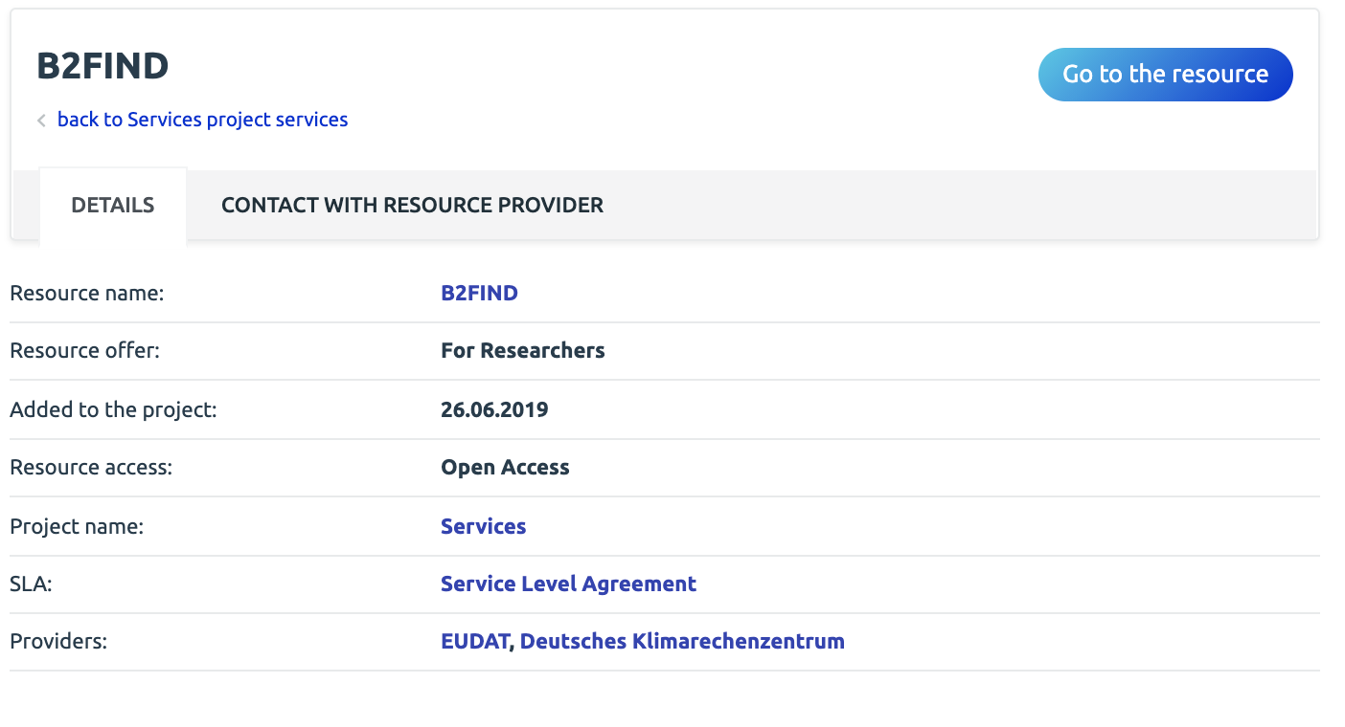
Support channels - projects
Contact with Resource Provider
Providers support when using the resource
Incident reporting
Contact with Project Support
For users looking for a help in selecting resources for their use cases
For users looking for help in composition of the infrastructure for their use case
For multi-provider use cases requiring EOSC experts guidance through technological or access policy aspects

Slide 20
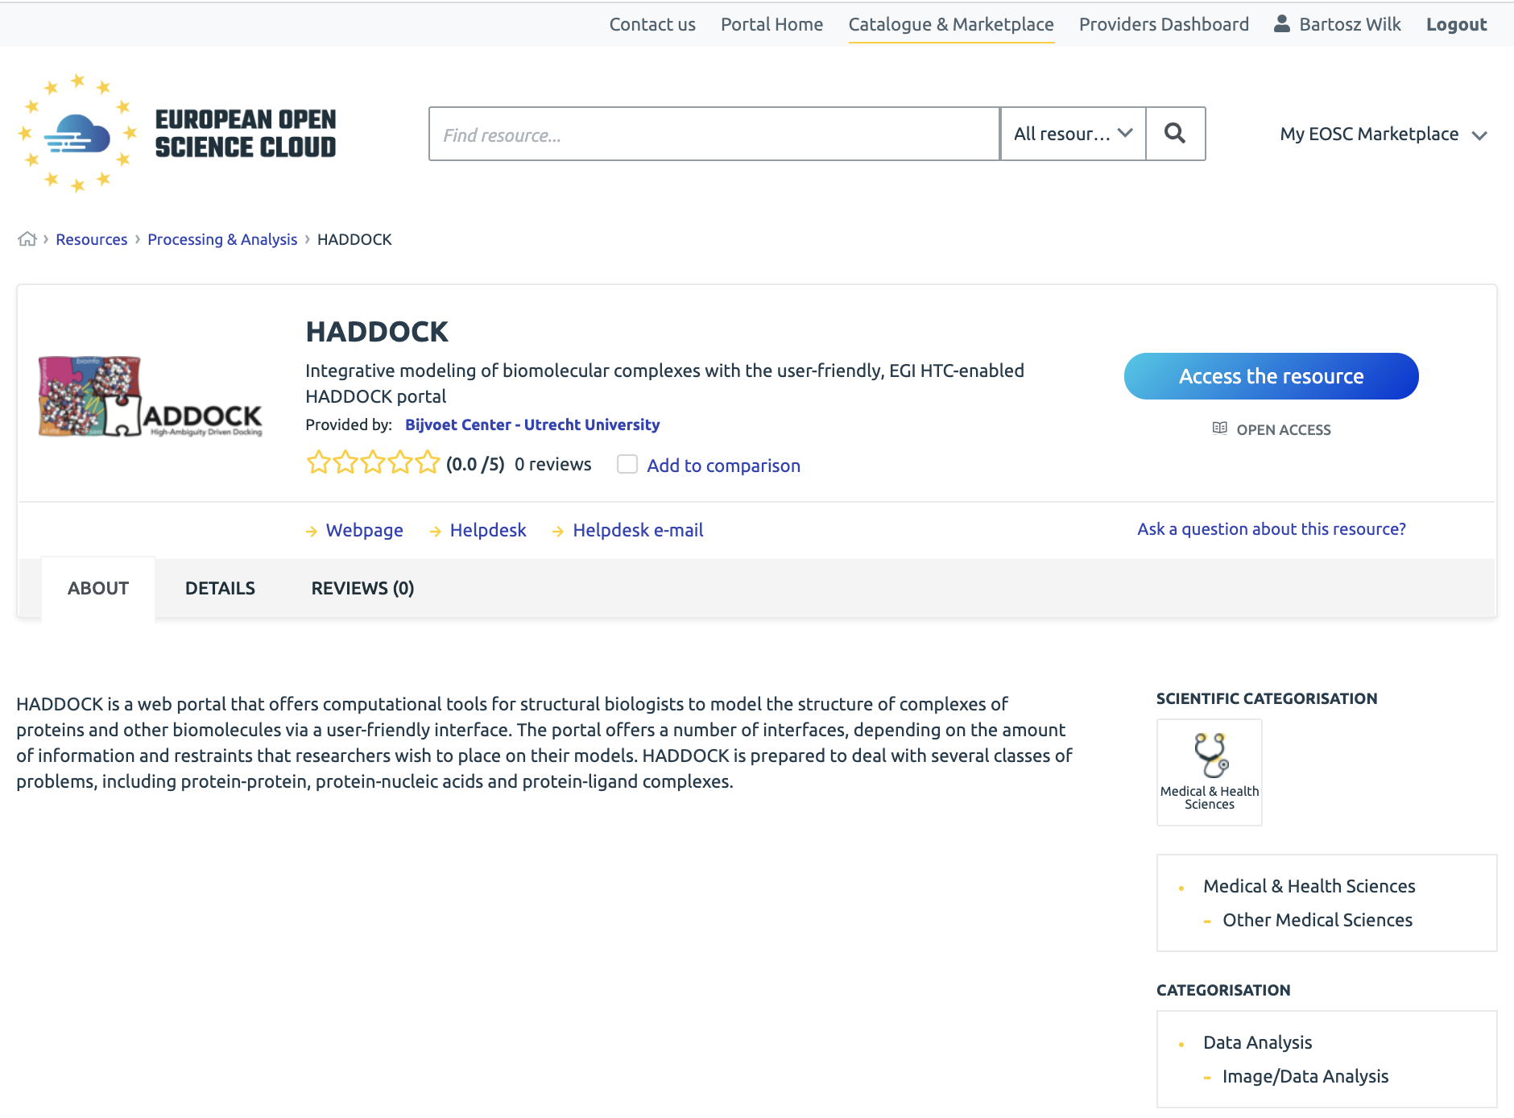
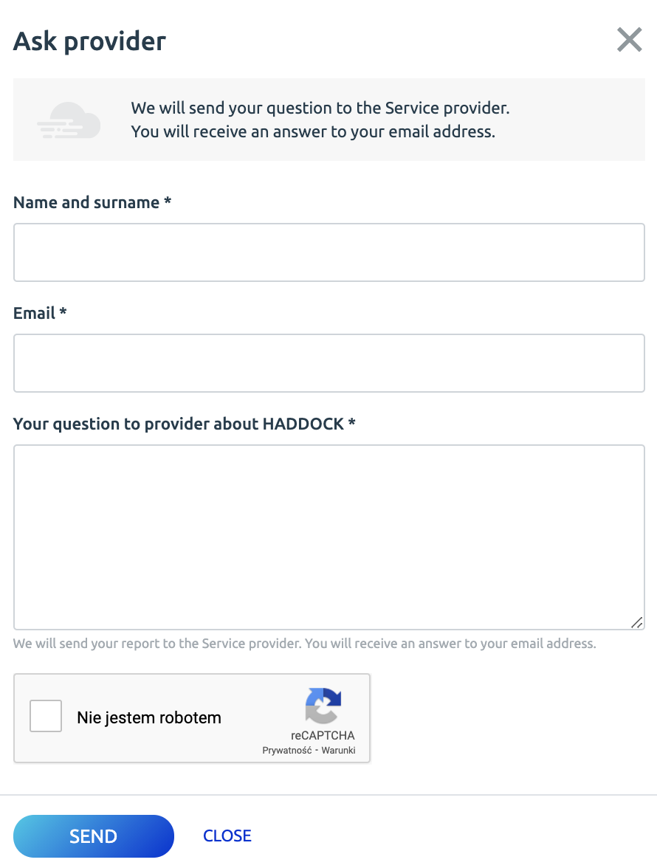
Other support channels
Resource Page -
“Ask a Question” button
A user can request clarification or ask a resource specific question
For authenticated and unauthenticated users
The question is sent straight to the providers
The communication is carried out over email

Slide 21
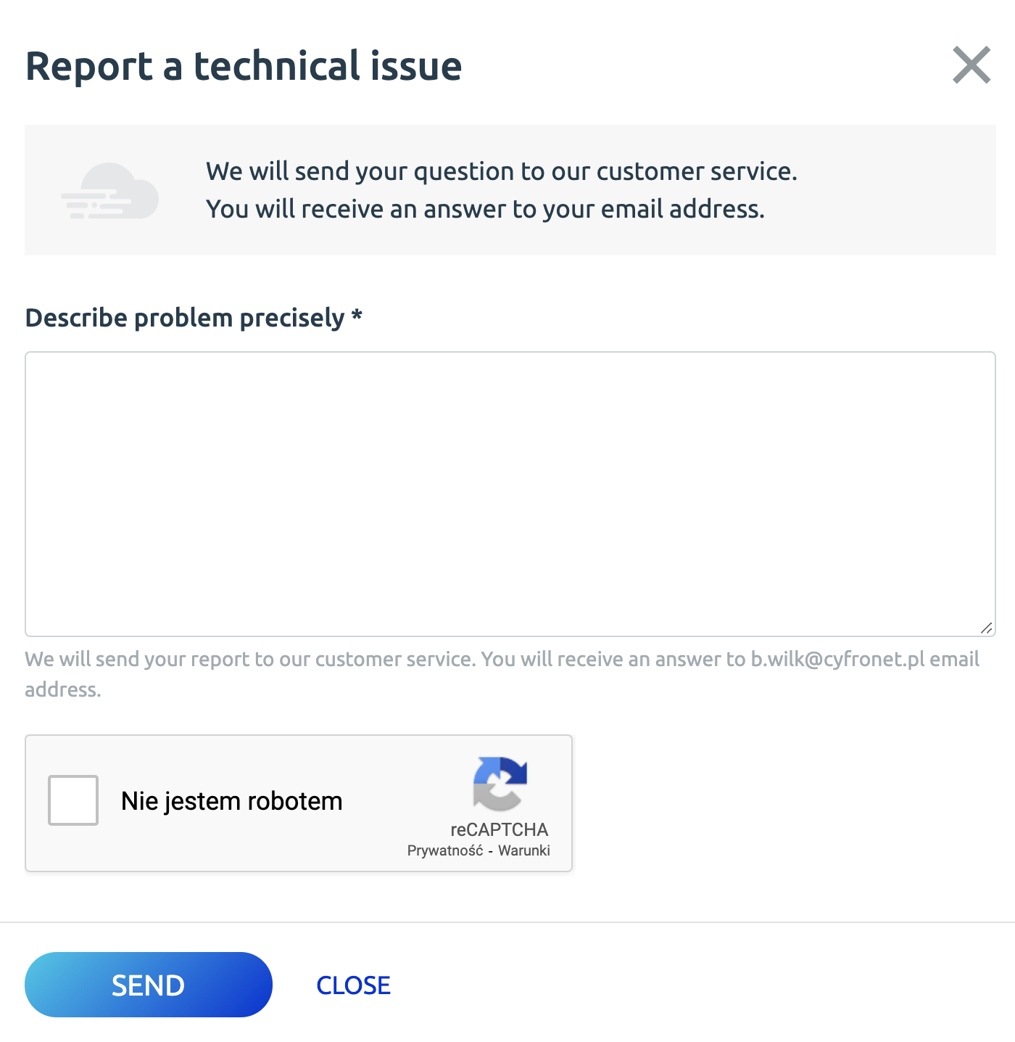
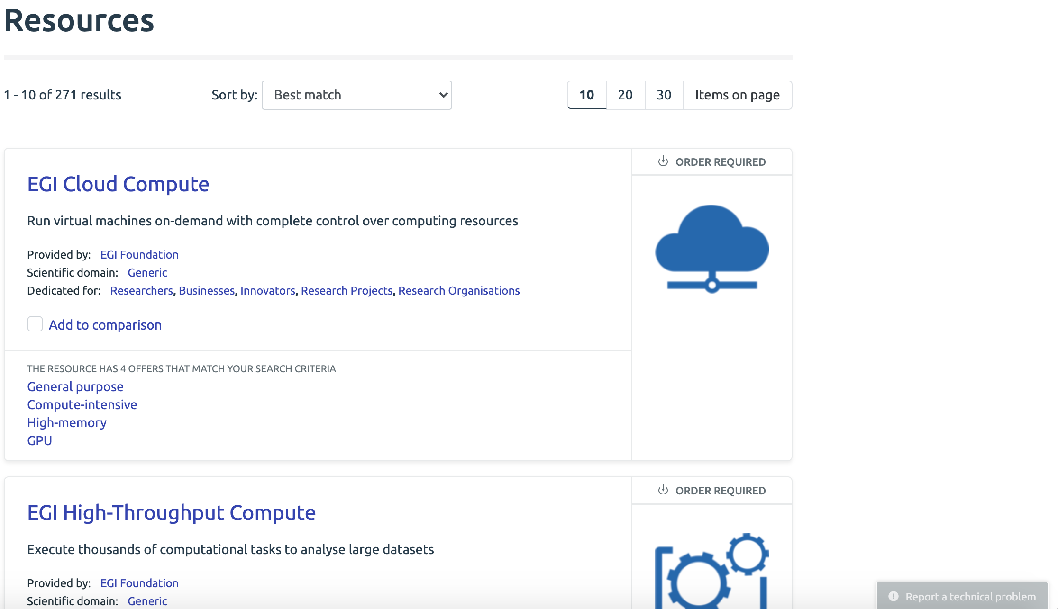
Other support channels
Technical issues
Report problems with the operation of EOSC Portal
FitSM - based operational procedures are in place to ensure indefectible operation and high availability
Issues are tracked and handled by the Portal support team in the XGus Helpdesk issue tracking system

Slide 22
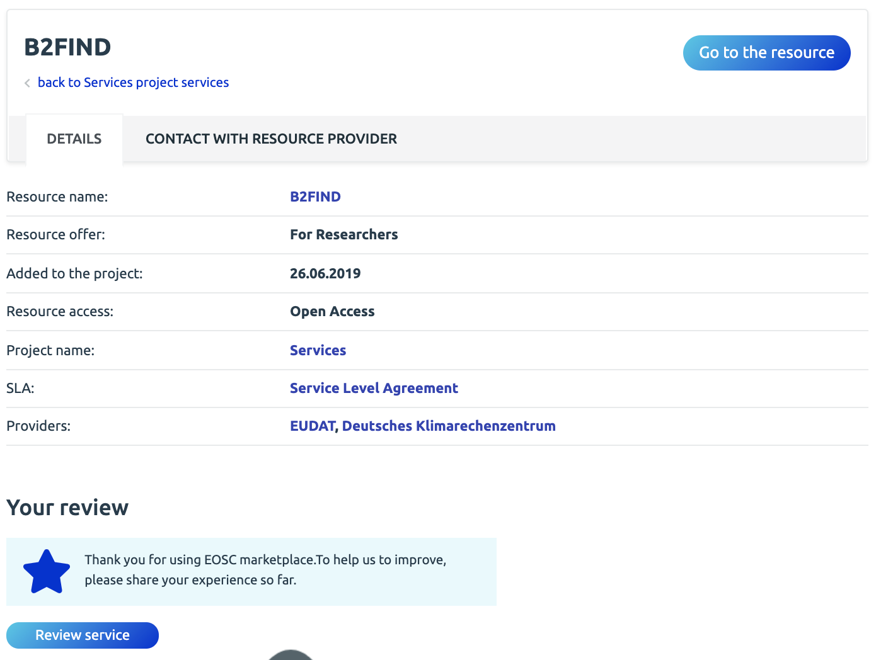
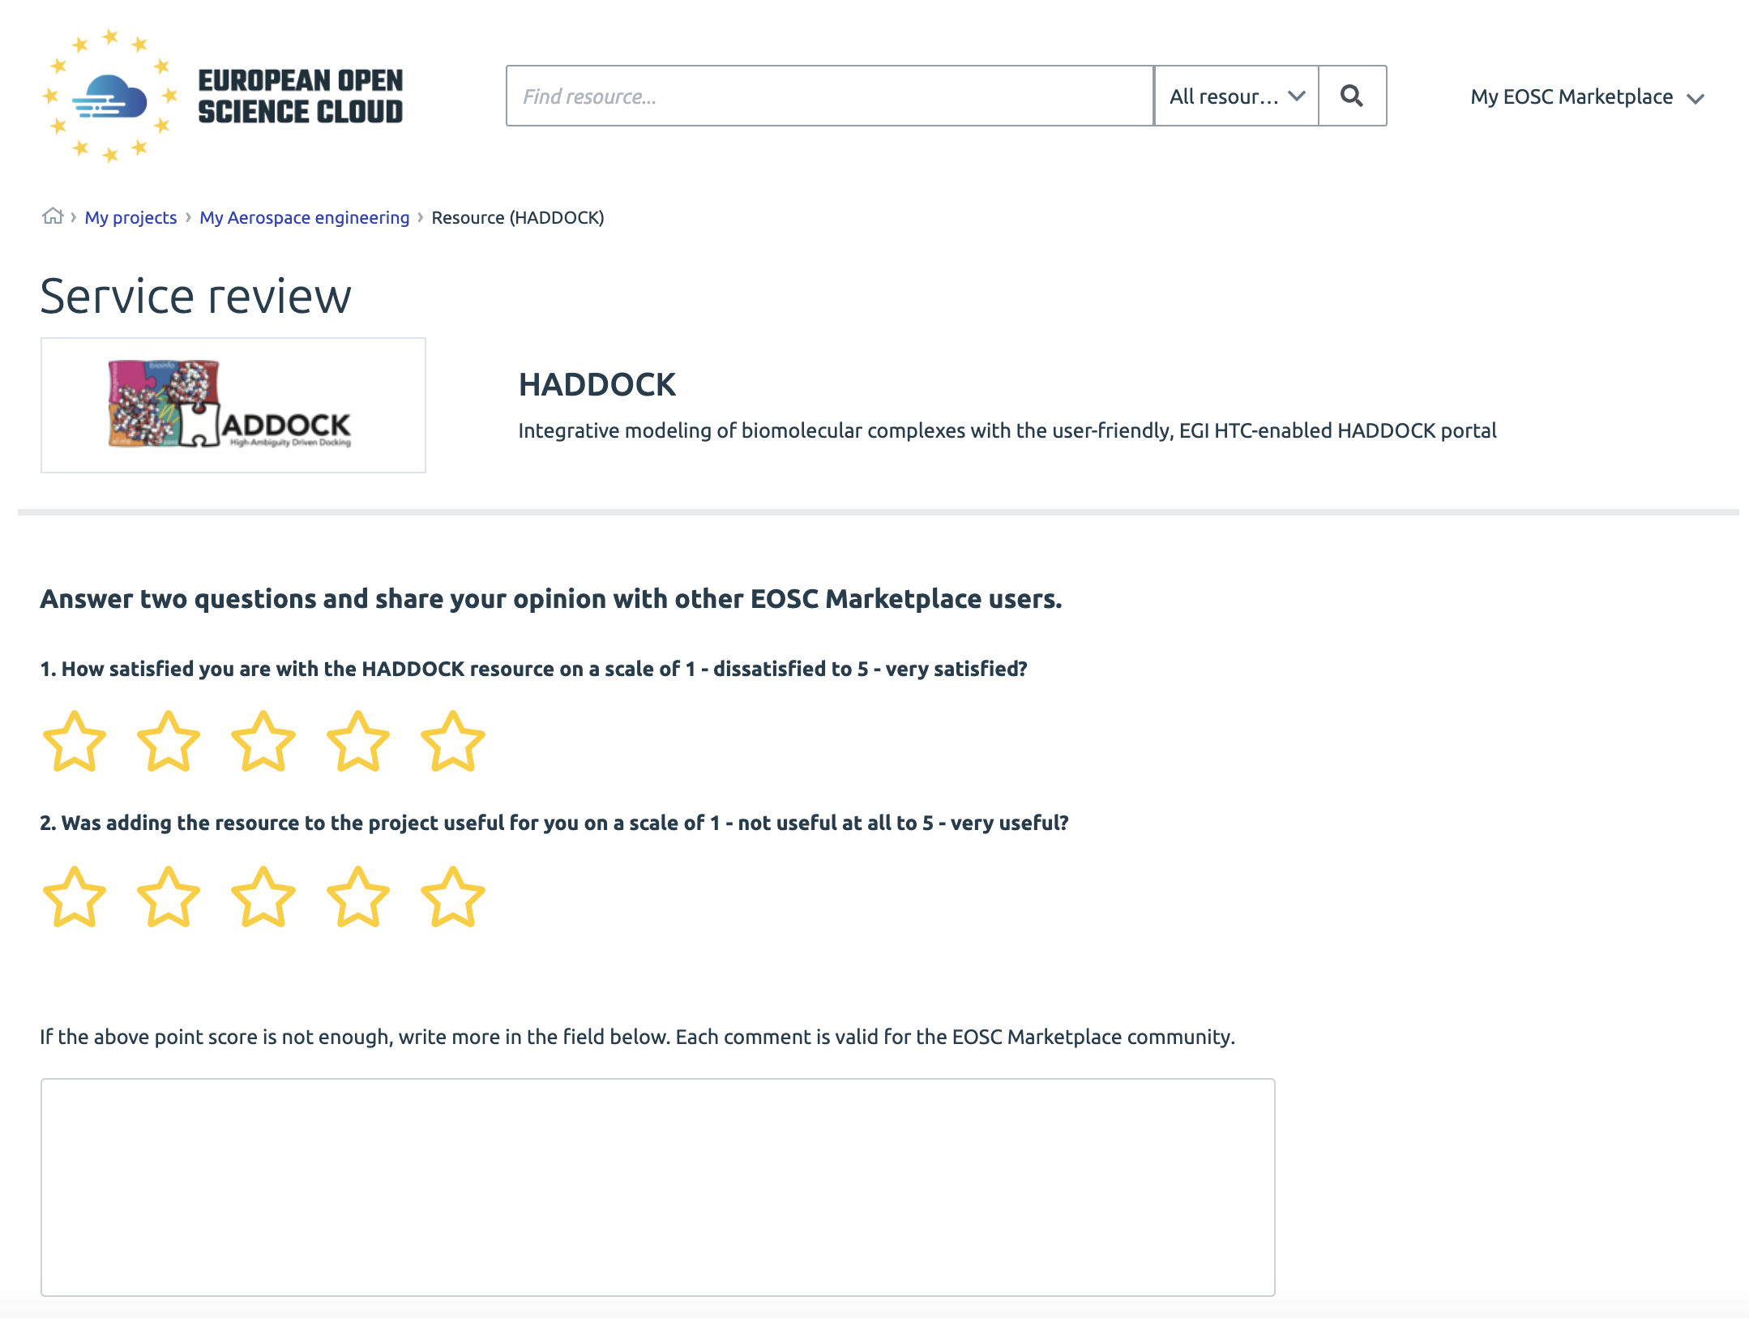
Feedback mechanisms
Service rating and opinions
Only used resources can be rated
To rate resources -> add them to your Project
User ratings are used to measure quality of the service delivered by the provider

Slide 23
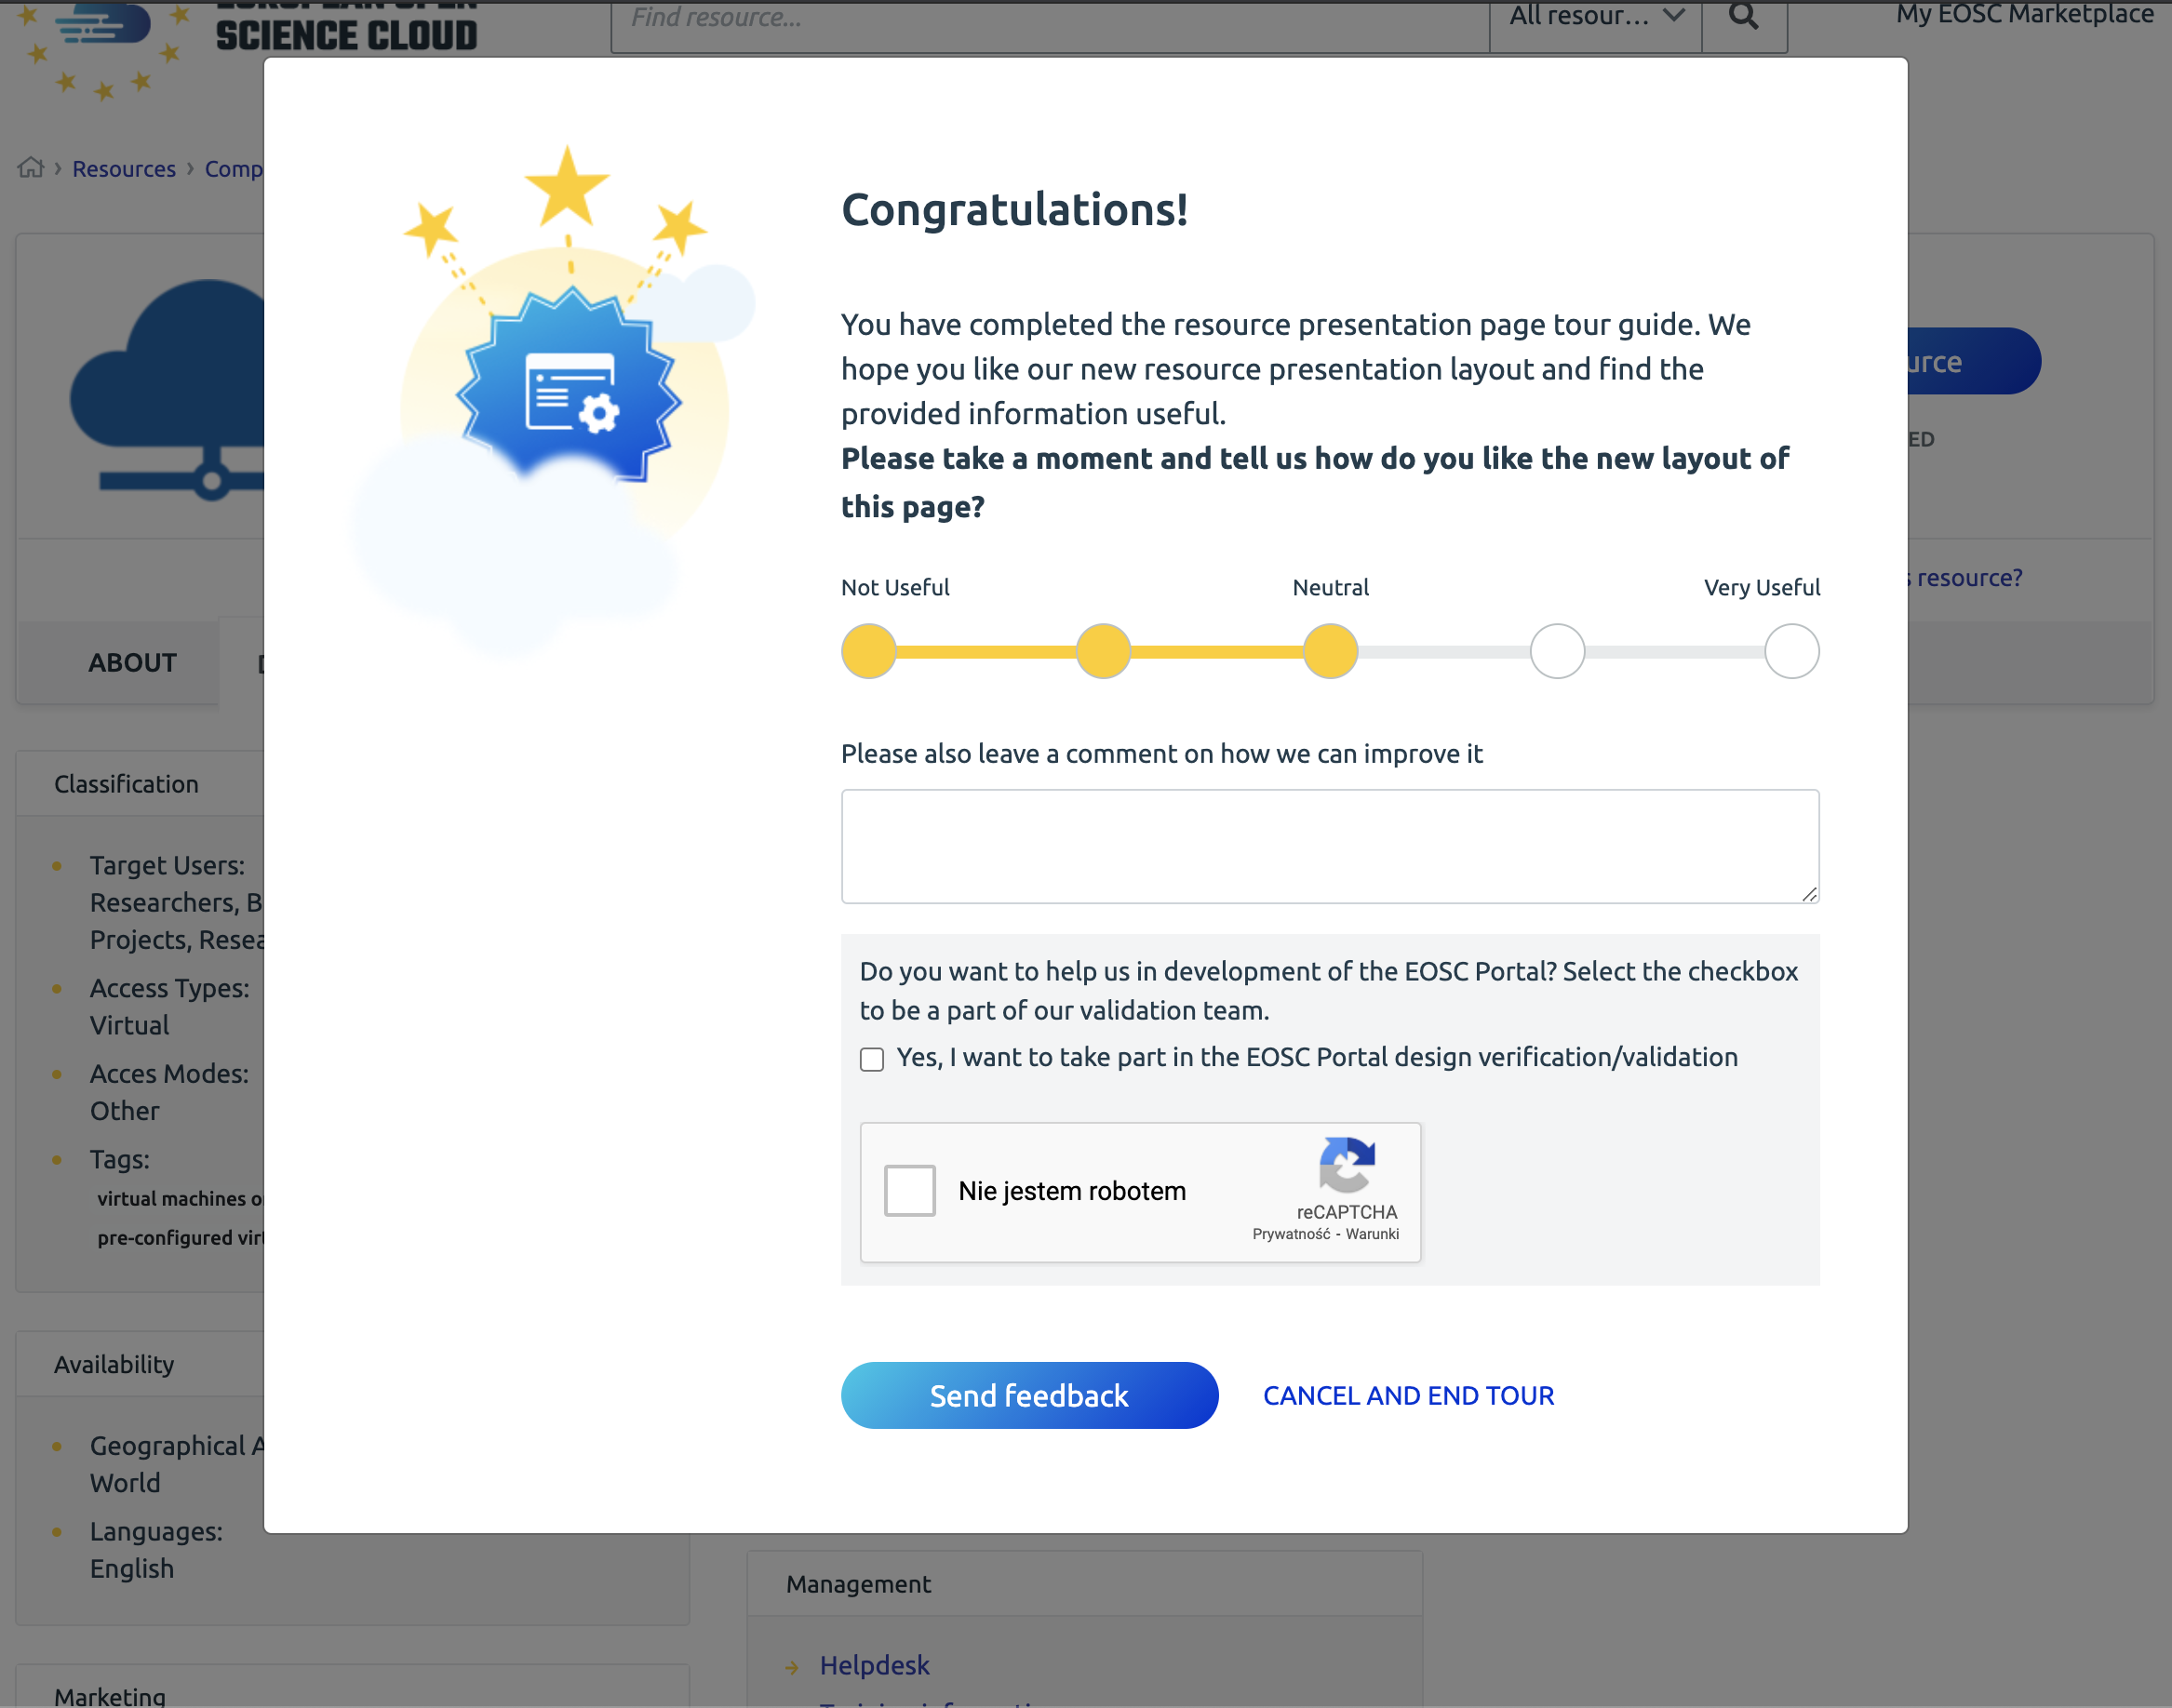
Feedback mechanisms
Features’ feedback
To measure user satisfaction for the newly developed EOSC Portal features, feedback collection mechanism is employed at the end of the feature tour guide
You can rate features and suggest changes for the Portal developers
Create the portal with us!

Slide 24
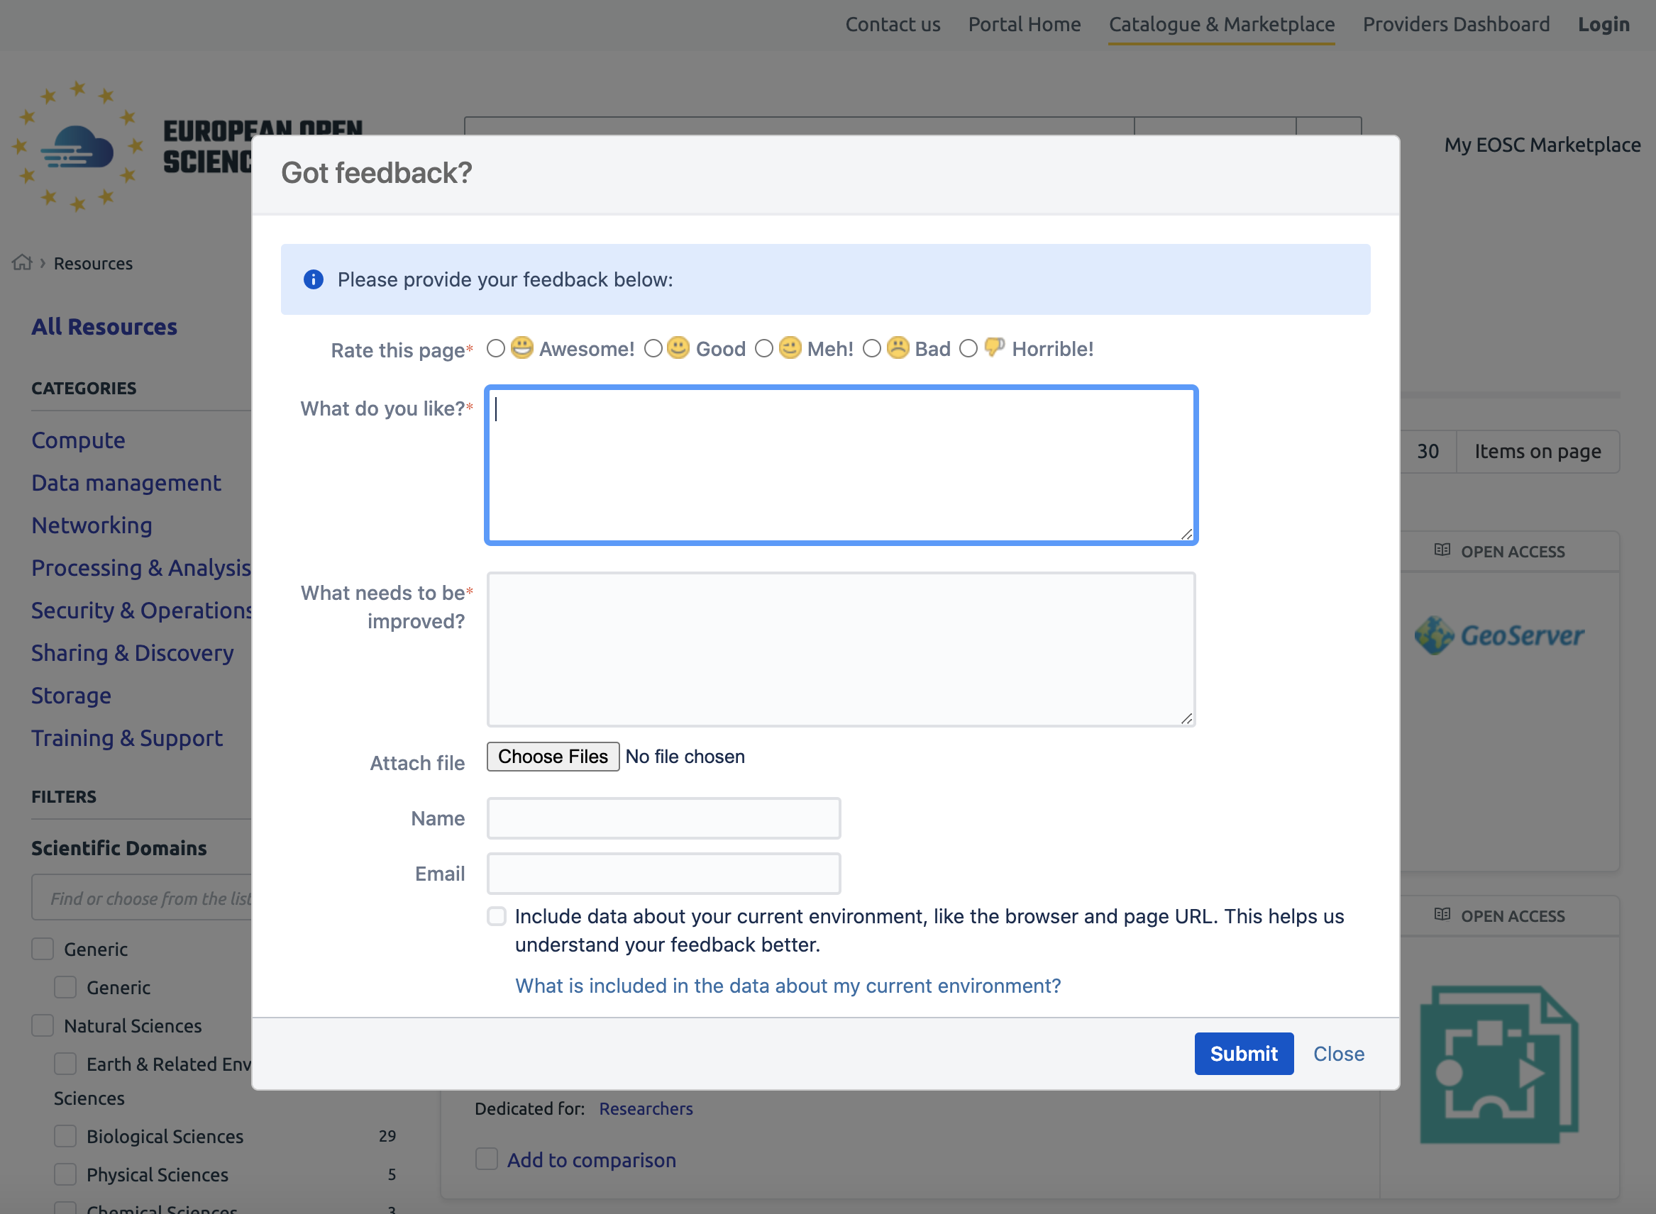
Feedback mechanisms
General EOSC Portal feedback mechanism
“Provide feedback” ribbon
If you have any suggestions for the EOSC Portal development, operational procedures, resource catalogue quality or EOSC in general you can express them directly in the Portal

