Slide 1
11 May 2021 EOSC Portal Virtual Meeting
Federico Drago – Trust-IT Services

Slide 2
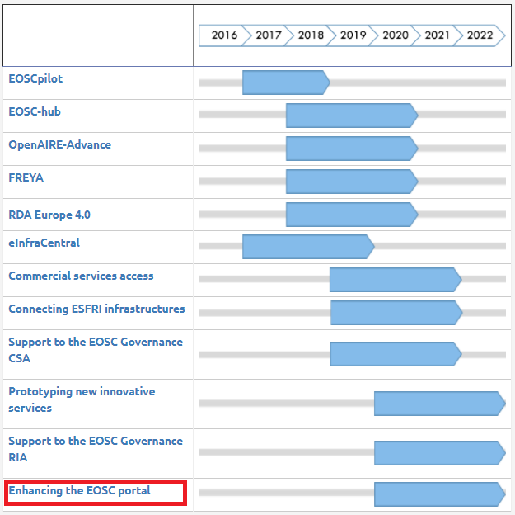
EOSC Enhance in context
Funded under INFRAEOSC-06-2019-2020: Enhancing the EOSC portal and connecting thematic clouds
Currently aligning with INFRAEOSC-03-2020: Integration and consolidation of the existing pan-European access mechanism to public research infrastructures and commercial services through the EOSC Portal

Slide 3
Objectives
Enhancing the service provider interface and incorporating new services and resources into the EOSC Portal catalogue
Increasing user demand for services and resources via EOSC Portal improvements and development
Accelerating the deployment and uptake of EOSC Portal services and resources
Enabling open access to services and data across thematic clouds
https://eosc-portal.eu/enhance
Check out:

Slide 4
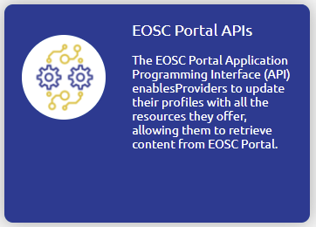
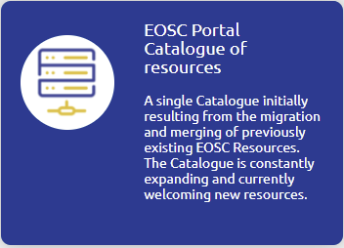
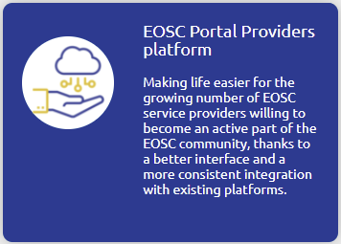
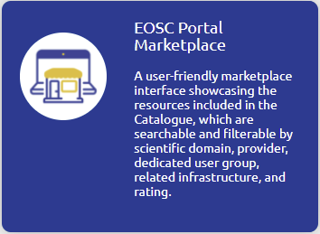
Key Exploitable Results
https://eosc-portal.eu/EOSC-Enhance-key-exploitable-results

Slide 5
EOSC Portal Requirements
Goals
Guide the future enhancements to the EOSC Portal
Collect insights on the needs of future EOSC users
Understand how to widen the EOSC Portal user and provider base
Public round of Requirements Gathering
Webinars carried out in Dec ’20 - Jan ‘21
Public virtual meetings with users and service providers in March and May 2021
EOSC Portal user survey: 26 April – 13 May 2021
Constant feedback collection via the website and onboarding team
Requirements gathering is a key activity for EOSC Enhance.
The EOSC Enhance team assesses and prioritises requirements for implementation

Slide 6
For Providers
Useful links
Providers Dashboard https://providers.eosc-portal.eu/provider/my
Providers documentation https://eosc-portal.eu/providers-documentation
Using the Portal https://eosc-portal.eu/using-the-portal
Promote your EOSC Portal service https://eosc-portal.eu/contribute-promotional-article-your-service
Submit your EOSC-related news/events https://eosc-portal.eu/contribute-to-eosc
Become a provider
Apply now! https://eosc-portal.eu/for-providers

